Slide 1
Learning sponsor
Putting a team around the practitioner to enable social workers to be agents of change for families
Phil Watson, Director of children’s services, Norfolk County Council
Hayley Griffin, Assistant director, children’s social care, Norfolk County Council
Paul Finon, Head of intensive and specialist support services, Norfolk County Council

Slide 2
Phil Watson
Director Children’s Social Care
Norfolk Children’s Services
phil.watson@norfolk.gov.uk

Slide 3
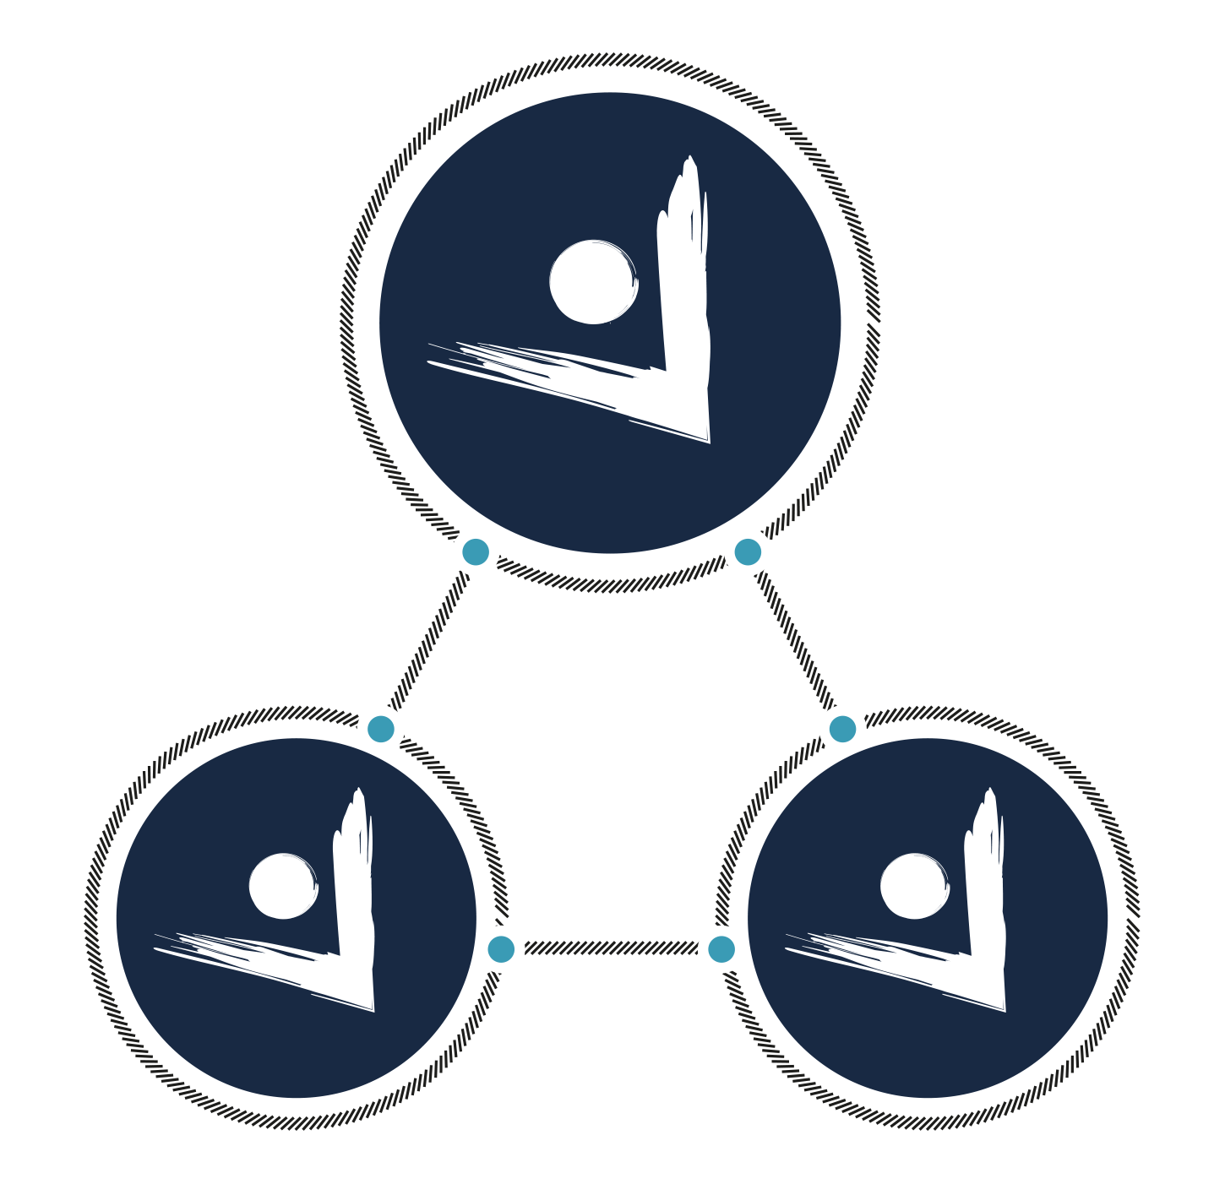
Norfolk Children’s Social Care
Where
relationships
matter!

Slide 4
1
It starts with you!
Who cares? We do - YouTube
So, how have we
gone about ensuring
relationships
matter?
Notes:
Holding slide

Slide 5
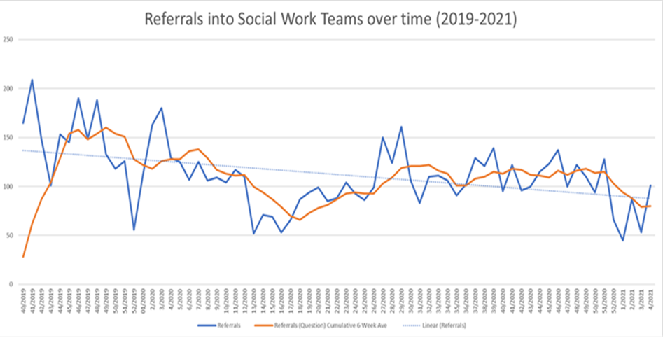
2
A different approach at our front door – banning written referrals and basing it on conversations and collaborative decision-making
So, how have we
gone about ensuring
relationships
matter?
Notes:
Holding slide

Slide 6
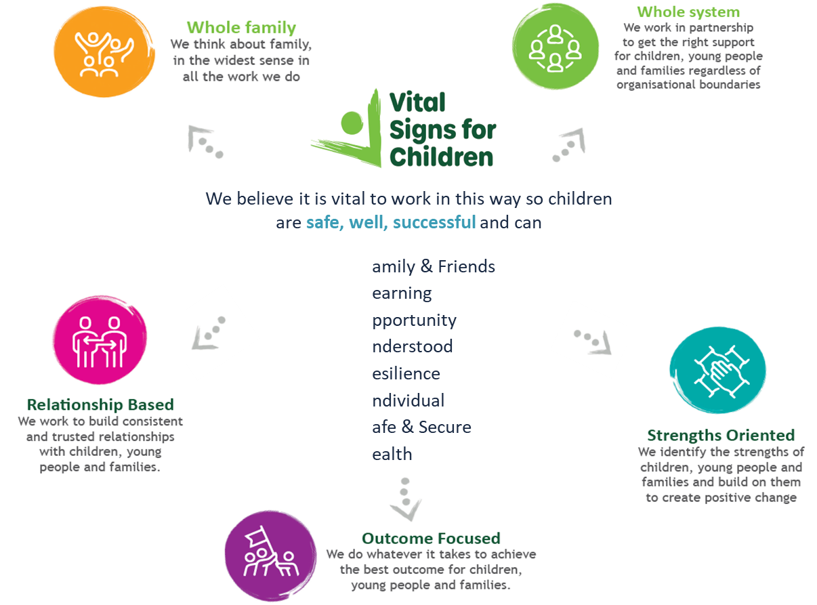
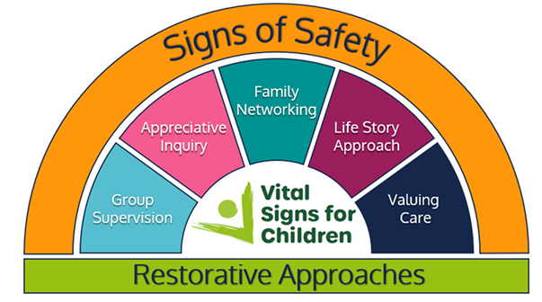
3
Introducing Vital Signs and our core ways of working relationships and working with families and their networks at it’s heart
So, how have we
gone about ensuring
relationships
matter?
Notes:
Holding slide

Slide 7
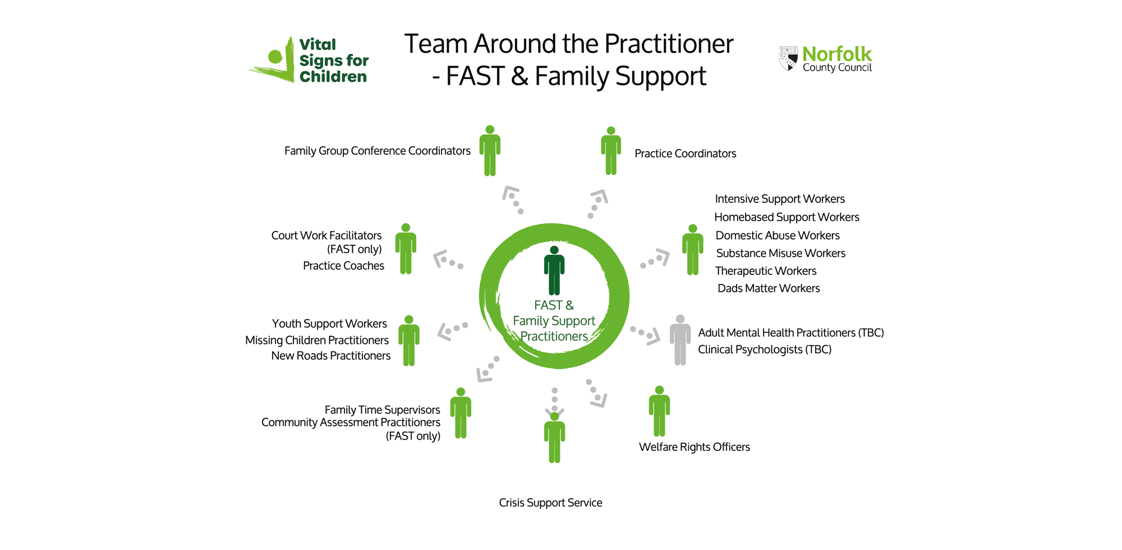
4
£20m+ investment in a Call-In Team Around the Practitioner model - a range of specialists and administrative support allowing practitioners to focus on their relationship with families
So, how have we
gone about ensuring
relationships
matter?
Notes:
Holding slide

Slide 8
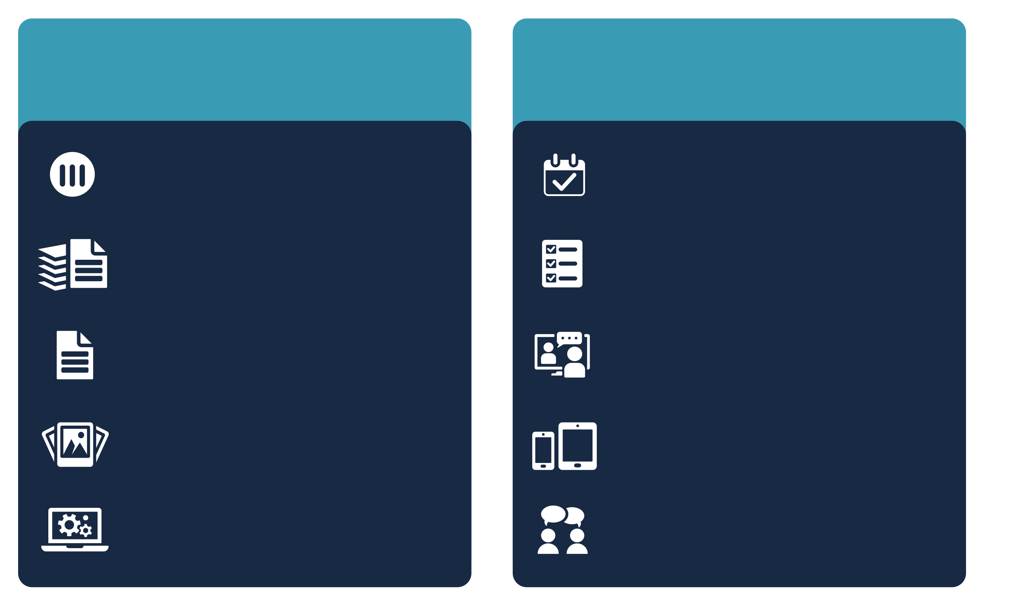
A new deal for Children’s Social Care
You are the intervention
Spend 80% of your working week with
children and families
We work flexibly
Have a fulfilling role and a healthy work-life balance
No more minutes for meetings – we will use the three columns format only
We will give you autonomy over your working pattern e.g. choice of days and time, condensed hours, part-time
We will significantly pare back our Signs of Safety forms to the essentials of the approach
Our managers will manage by productivity, not presence
We will markedly reduce the number of forms you fill out and introduce word units
Each professional meeting will have hybrid provisions, so staff can choose whether to attend virtually or in person
We give explicit permission to make case records visual, succinct and analytical. We will provide training and examples to support you to do so
Staff will have access to and use their IT kit (smartphones and tablets/laptops) from day one
We will continue to invest in and expect use of technology, e.g. voice recognition software, mobile Liquid Logic, portals
Practitioners will receive monthly personal supervision and be freed up for one day a month of training and CPD

Slide 9
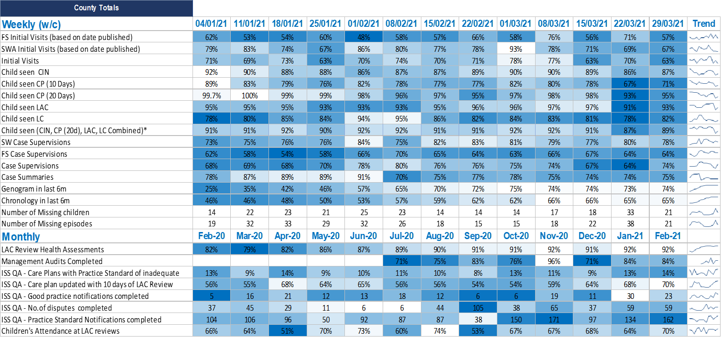
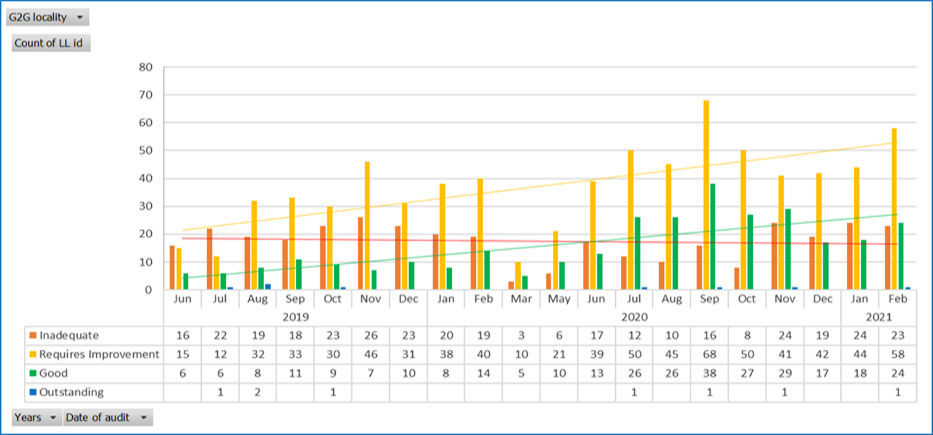
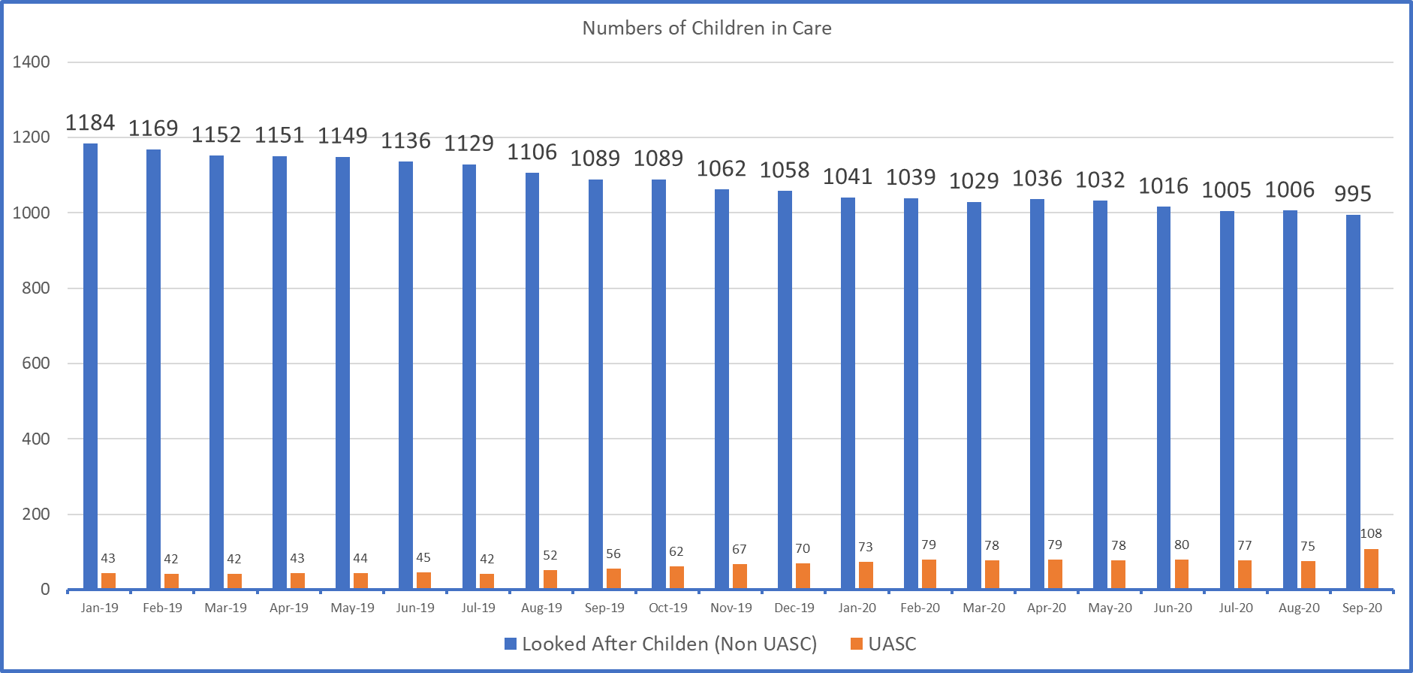
The difference
1
The timeliness and quality of work has continued to get better
2
2
We have far fewer children in the care system

Slide 10
The difference
3
We have reduced our reliance on agency staff by 2/3!
2
We’re increasingly talking about our areas of great practice on a regional and national stage eg. CADS, UASC, Call-In Model
Increased applications and interest in working in Norfolk – so join while you still can!
4
5

Slide 11
Learning sponsor

